Slide 1

Data-Intensive Distributed Computing
CS 431/631 451/651 (Winter 2019)
Part 3: Analyzing Text (1/2)
January 29, 2019
Adam Roegiest
Kira Systems
These slides are available at http://roegiest.com/bigdata-2019w/
This work is licensed under a Creative Commons Attribution-Noncommercial-Share Alike 3.0 United States See http://creativecommons.org/licenses/by-nc-sa/3.0/us/ for details

Slide 2
Structure of the Course
“Core” framework features and algorithm design

Slide 3
Data-Parallel Dataflow Languages
We have a collection of records,
want to apply a bunch of operations to compute some result
What are the dataflow operators?
Spark is a better MapReduce with a few more “niceties”!
Moving forward: generic reference to “mapper” and “reducers”

Slide 4
Structure of the Course
Analyzing Text
Analyzing Relational Data
Analyzing Graphs
Data Mining
“Core” framework features and algorithm design

Slide 5

Count.
Source: http://www.flickr.com/photos/guvnah/7861418602/

Slide 6
Count
(Efficiently)
class Mapper {
def map(key: Long, value: String) = {
for (word <- tokenize(value)) {
emit(word, 1)
}
}
}
class Reducer {
def reduce(key: String, values: Iterable[Int]) = {
for (value <- values) {
sum += value
}
emit(key, sum)
}
}

Slide 7
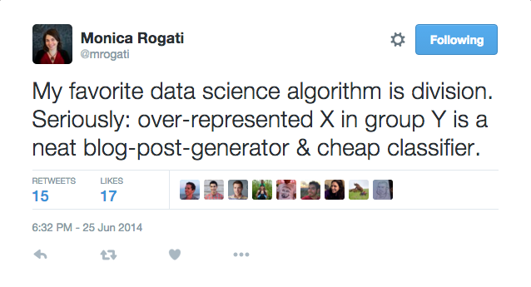
Count.
Divide.
Source: http://www.flickr.com/photos/guvnah/7861418602/ https://twitter.com/mrogati/status/481927908802322433

Slide 8
Pairs. Stripes.
Seems pretty trivial…
More than a “toy problem”?
Answer: language models

Slide 9
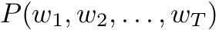
Language Models
What are they?
How do we build them?
How are they useful?
Notes:
Sentence with T words - assign a probability to it

Slide 10
Language Models
[chain rule]
Is this tractable?
Notes:
Sentence with T words - assign a probability to it

Slide 11
Approximating Probabilities: N-Grams
Basic idea: limit history to fixed number of (N – 1) words
(Markov Assumption)
N=1: Unigram Language Model

Slide 12
Approximating Probabilities: N-Grams
Basic idea: limit history to fixed number of (N – 1) words
(Markov Assumption)
N=2: Bigram Language Model
Notes:
Since we also want to include the first word in the bigram model, we need a dummy beginning of sentence marker <s>. We usually also have an end of sentence marker but for the sake of brevity, I don’t show that here.

Slide 13
Approximating Probabilities: N-Grams
Basic idea: limit history to fixed number of (N – 1) words
(Markov Assumption)
N=3: Trigram Language Model

Slide 14
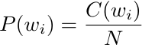
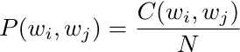
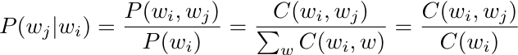
Building N-Gram Language Models
Compute maximum likelihood estimates (MLE) for
Individual n-gram probabilities
Fancy way of saying: count + divide
Unigram
Bigram
?
Minor detail here…
Generalizes to higher-order n-grams
State of the art models use ~5-grams
We already know how to do this in MapReduce!
Notes:
N-gram probability estimates. Derive the conditional probability expression on board ! Given that the occurrence of an n-gram is a random variable with a binomial distribution i.e. each n-gram is independent of the next. Untrue: (a) n-grams are overlapping (b) content words tend to clump (used once, likely to get used again)

Slide 15
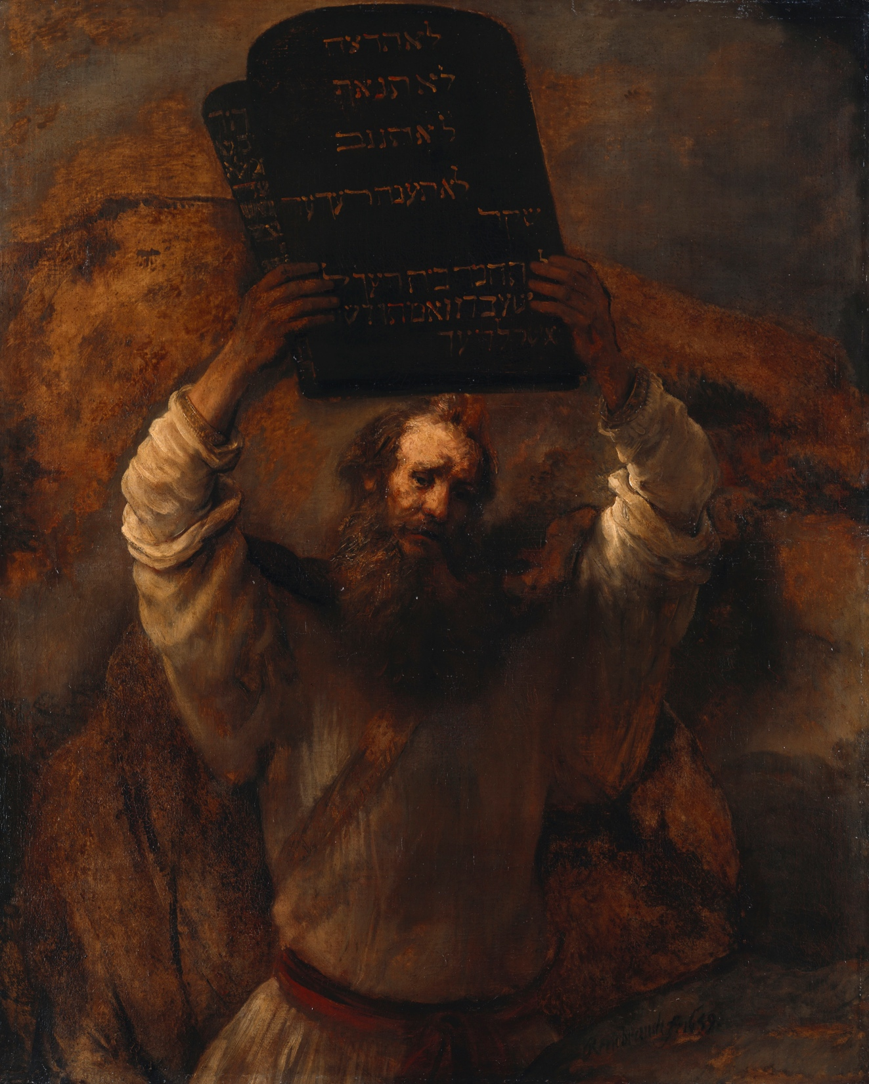
The two commandments of estimating probability distributions…
Source: Wikipedia (Moses)

Slide 16
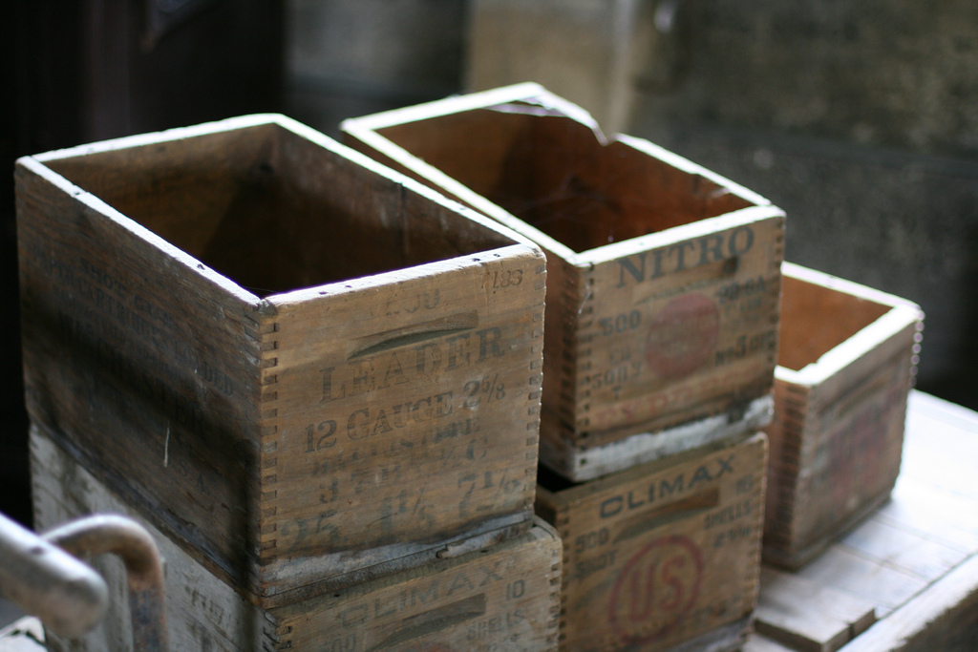
Probabilities must sum up to one
Source: http://www.flickr.com/photos/37680518@N03/7746322384/

Slide 17
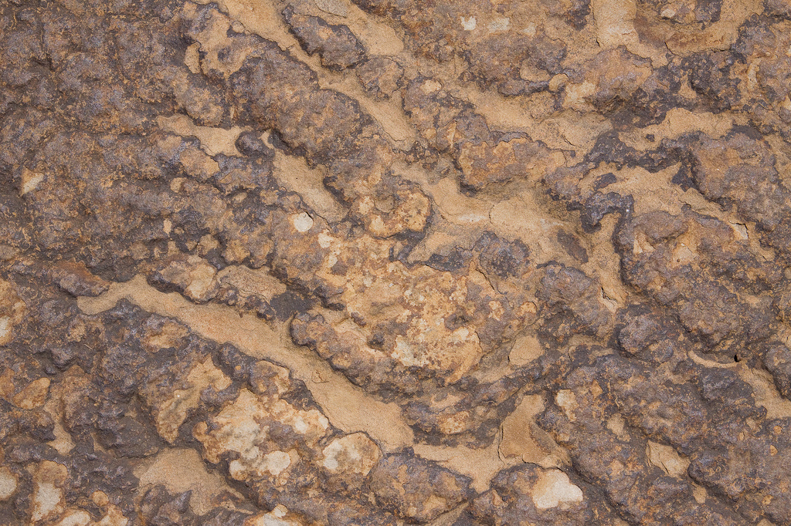
Thou shalt smooth
What? Why?
Source: http://www.flickr.com/photos/brettmorrison/3732910565/

Slide 18
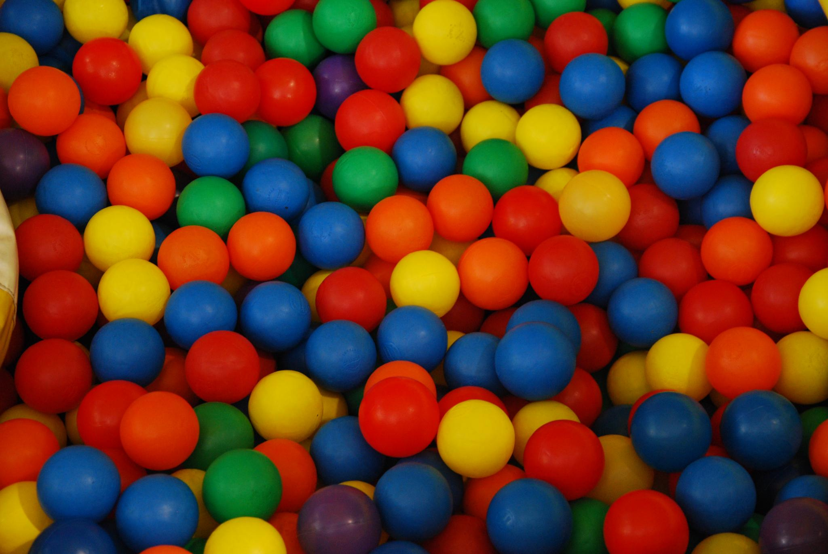
Source: https://www.flickr.com/photos/avlxyz/6898001012/

Slide 19
P( ) > P ( )
P( ) ? P ( )

Slide 20
Example: Bigram Language Model
<s>
I am Sam Sam I am
I do not like green eggs and ham
</s>
<s>
</s>
<s>
</s>
Training Corpus
P( I | <s> ) = 2/3 = 0.67 P( Sam | <s> ) = 1/3 = 0.33
P( am | I ) = 2/3 = 0.67 P( do | I ) = 1/3 = 0.33
P( </s> | Sam )= 1/2 = 0.50 P( Sam | am) = 1/2 = 0.50
...
Bigram Probability Estimates
Note: We don’t ever cross sentence boundaries

Slide 21
Data Sparsity
P( I | <s> ) = 2/3 = 0.67 P( Sam | <s> ) = 1/3 = 0.33
P( am | I ) = 2/3 = 0.67 P( do | I ) = 1/3 = 0.33
P( </s> | Sam )= 1/2 = 0.50 P( Sam | am) = 1/2 = 0.50
...
Bigram Probability Estimates
P(I like ham)
= P( I | <s> ) P( like | I ) P( ham | like ) P( </s> | ham )
= 0
Why is this bad?
Issue: Sparsity!
Notes:
Why is the 0 bad ?

Slide 22
Thou shalt smooth!
Zeros are bad for any statistical estimator
Need better estimators because MLEs give us a lot of zeros
A distribution without zeros is “smoother”
The Robin Hood Philosophy: Take from the rich (seen n-grams) and give to the poor (unseen n-grams)
Need better estimators because MLEs give us a lot of zeros
A distribution without zeros is “smoother”
Lots of techniques:
Laplace, Good-Turing, Katz backoff, Jelinek-Mercer
Kneser-Ney represents best practice

Slide 23
Laplace Smoothing
Learn fancy words for simple ideas!
Simplest and oldest smoothing technique
Just add 1 to all n-gram counts including the unseen ones
So, what do the revised estimates look like?

Slide 24
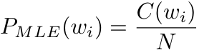
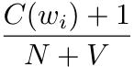
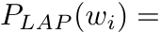
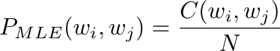
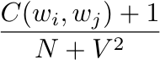
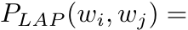
Laplace Smoothing
Unigrams
Bigrams
Careful, don’t confuse the N’s!
What if we don’t know V?
Notes:
You have to make sure that the joint is well-formed and understand how the conditional probability formula is derived.

Slide 25
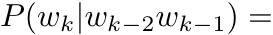
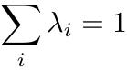
Jelinek-Mercer Smoothing: Interpolation
Mix higher-order with lower-order models to defeat sparsity
Mix = Weighted Linear Combination

Slide 26
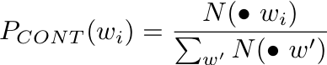
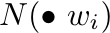
Kneser-Ney Smoothing
Interpolate discounted model with a
special “continuation” n-gram model
Based on appearance of n-grams in different contexts
Excellent performance, state of the art
= number of different contexts w_{i} has appeared in

Slide 27
Kneser-Ney Smoothing: Intuition
I can’t see without my __________
“San Francisco” occurs a lot
I can’t see without my Francisco?

Slide 28
Stupid Backoff
Let’s break all the rules:
But throw lots of data at the problem!
Source: Brants et al. (EMNLP 2007)

Slide 29
What the…
Source: Wikipedia (Moses)

Slide 30
Stupid Backoff Implementation: Pairs!
Straightforward approach: count each order separately
A B
A B C
A B D
A B E
…
S(C|A B) = f(A B C)/f(A B)
S(D|A B) = f(A B D)/f(A B)
S(E|A B) = f(A B E)/f(A B)
…
remember this value
More clever approach: count all orders together
A B
A B C
A B C P
A B C Q
A B D
A B D X
A B D Y
…
remember this value
remember this value
remember this value

Slide 31
Stupid Backoff: Additional Optimizations
Replace strings with integers
Assign ids based on frequency (better compression using vbyte)
Partition by bigram for better load balancing
Replicate all unigram counts

Slide 32

State of the art smoothing (less data)
vs. Count and divide (more data)
Source: Wikipedia (Boxing)

Slide 33

Statistical Machine Translation
Source: Wikipedia (Rosetta Stone)

Slide 34
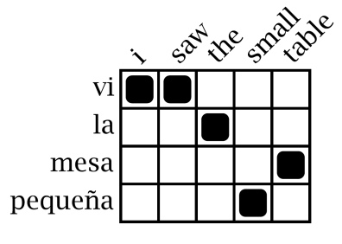
Statistical Machine Translation
Word Alignment
Phrase Extraction
Training Data
i saw the small table
(vi, i saw)
(la mesa pequeña, the small table)
…
vi la mesa pequeña
Parallel Sentences
he sat at the table
the service was good
Language Model
Translation Model
Target-Language Text
Decoder
maria no daba una bofetada a la bruja verde
mary did not slap the green witch
Foreign Input Sentence
English Output Sentence

Slide 35
Translation as a Tiling Problem
Maria
no
dio
una
bofetada
a
la
bruja
verde
Mary
Mary
not
give
a
slap
to
the
witch
green
did not
by
did not
a slap
green witch
green witch
no
slap
to the
slap
did not give
to
the
the
slap
the witch

Slide 36
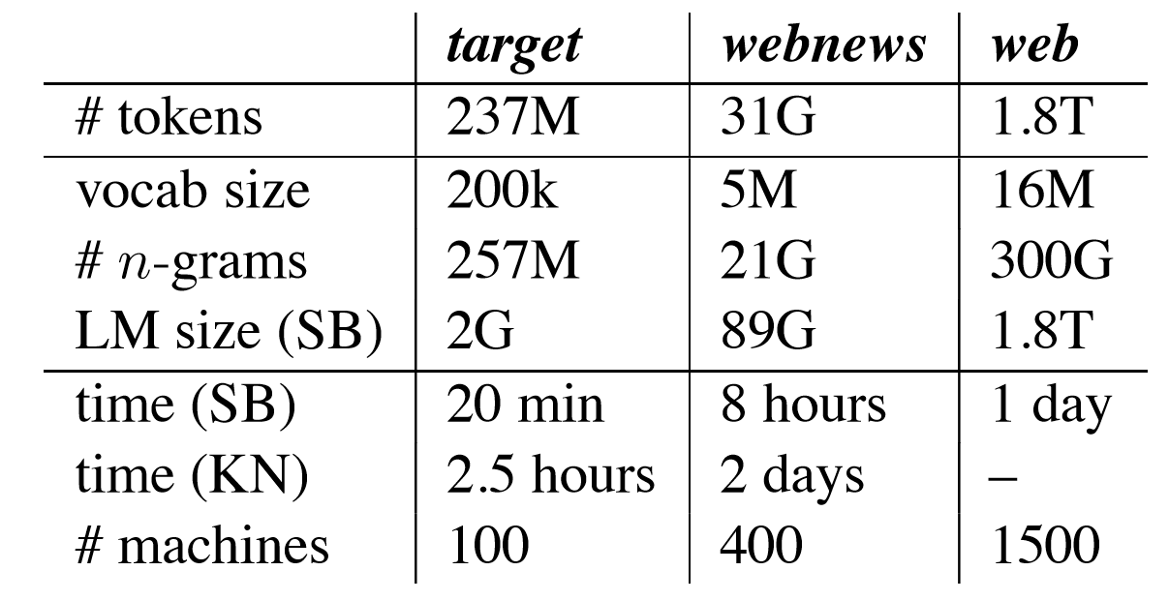
Results: Running Time
Source: Brants et al. (EMNLP 2007)

Slide 37
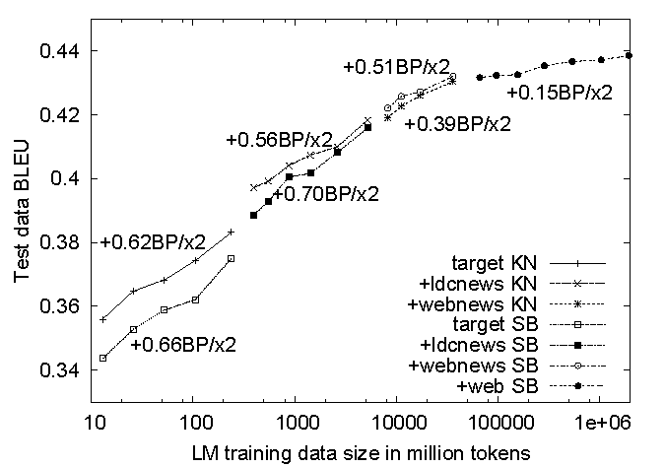
Results: Translation Quality
Source: Brants et al. (EMNLP 2007)

Slide 38
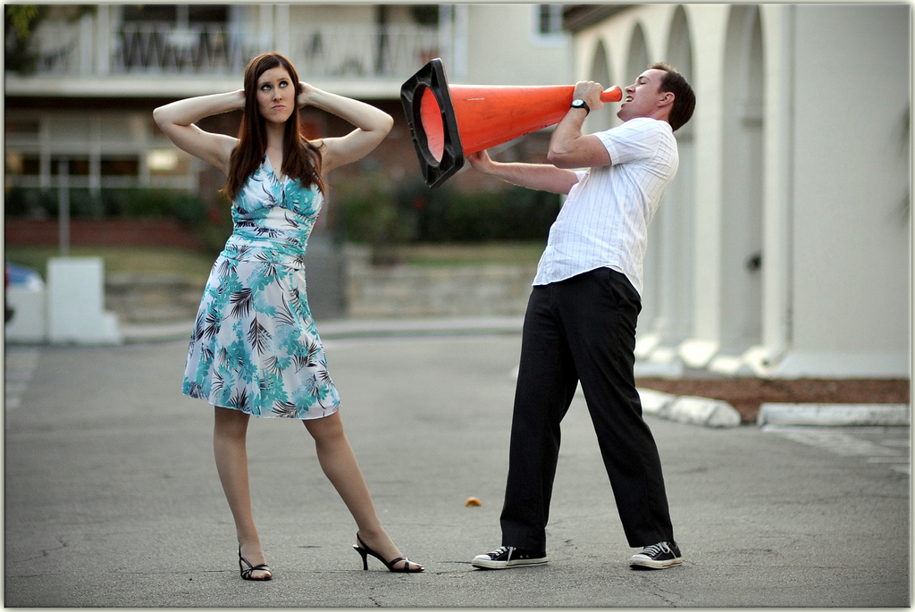
What’s actually going on?
English
French
channel
Source: http://www.flickr.com/photos/johnmueller/3814846567/in/pool-56226199@N00/

Slide 39
Signal
Text
channel
It’s hard to recognize speech
It’s hard to wreck a nice beach
Source: http://www.flickr.com/photos/johnmueller/3814846567/in/pool-56226199@N00/

Slide 40
receive
recieve
channel
autocorrect #fail
Source: http://www.flickr.com/photos/johnmueller/3814846567/in/pool-56226199@N00/

Slide 41
Neural Networks
Have taken over…

Slide 42
Search!
Source: http://www.flickr.com/photos/guvnah/7861418602/

Slide 43
First, nomenclature…
Search and information retrieval (IR)
Focus on textual information (= text/document retrieval)
Other possibilities include image, video, music, …
What do we search?
Generically, “collections”
Less-frequently used, “corpora”
What do we find?
Generically, “documents”
Though “documents” may refer to web pages, PDFs, PowerPoint, etc.

Slide 44
The Central Problem in Search
Author
Searcher
Concepts
Concepts
Query Terms
Document Terms
“tragic love story”
“fateful star-crossed romance”
Do these represent the same concepts?
Notes:
Why is IR hard? Because language is hard!

Slide 45
Abstract IR Architecture
Documents
Query
document acquisition (e.g., web crawling)
online
offline
Representation
Function
Representation
Function
Query Representation
Document Representation
Index
Comparison
Function
Hits

Slide 46
How do we represent text?
Remember: computers don’t “understand” anything!
“Bag of words”
Treat all the words in a document as index terms
Assign a “weight” to each term based on “importance” (or, in simplest case, presence/absence of word)
Disregard order, structure, meaning, etc. of the words
Simple, yet effective!
Assumptions
Term occurrence is independent
Document relevance is independent
“Words” are well-defined

Slide 47
What’s a word?
天主教教宗若望保祿二世因感冒再度住進醫院。這是他今年第二度因同樣的病因住院。
وقال مارك ريجيف - الناطق باسم
الخارجية الإسرائيلية - إن شارون قبل
الدعوة وسيقوم للمرة الأولى بزيارة
تونس، التي كانت لفترة طويلة المقر
الرسمي لمنظمة التحرير الفلسطينية بعد خروجها من لبنان عام 1982.
Выступая в Мещанском суде Москвы экс-глава ЮКОСа заявил не совершал ничего противозаконного, в чем обвиняет его генпрокуратура России.
भारत सरकार ने आर्थिक सर्वेक्षण में वित्तीय वर्ष 2005-06 में सात फ़ीसदी विकास दर हासिल करने का आकलन किया है और कर सुधार पर ज़ोर दिया है
日米連合で台頭中国に対処…アーミテージ前副長官提言
조재영 기자= 서울시는 25일 이명박 시장이 `행정중심복합도시'' 건설안에 대해 `군대라도 동원해 막고싶은 심정''이라고 말했다는 일부 언론의 보도를 부인했다.

Slide 48
Sample Document
McDonald's slims down spuds
Fast-food chain to reduce certain types of fat in its french fries with new cooking oil.
NEW YORK (CNN/Money) - McDonald's Corp. is cutting the amount of "bad" fat in its french fries nearly in half, the fast-food chain said Tuesday as it moves to make all its fried menu items healthier.
But does that mean the popular shoestring fries won't taste the same? The company says no. "It's a win-win for our customers because they are getting the same great french-fry taste along with an even healthier nutrition profile," said Mike Roberts, president of McDonald's USA.
But others are not so sure. McDonald's will not specifically discuss the kind of oil it plans to use, but at least one nutrition expert says playing with the formula could mean a different taste.
Shares of Oak Brook, Ill.-based McDonald's (MCD: down $0.54 to $23.22, Research, Estimates) were lower Tuesday afternoon. It was unclear Tuesday whether competitors Burger King and Wendy's International (WEN: down $0.80 to $34.91, Research, Estimates) would follow suit. Neither company could immediately be reached for comment.
…
“Bag of Words”
14 × McDonalds
12 × fat
11 × fries
8 × new
7 × french
6 × company, said, nutrition
5 × food, oil, percent, reduce, taste, Tuesday
…

Slide 49
Counting Words…
Documents
case folding, tokenization, stopword removal, stemming
Bag of Words
syntax, semantics, word knowledge, etc.
Inverted
Index

Slide 50
Count.
Source: http://www.flickr.com/photos/guvnah/7861418602/

Slide 51
Doc 1
Doc 2
Doc 3
Doc 4
one fish, two fish
red fish, blue fish
cat in the hat
green eggs and ham
1
2
3
4
What goes in each cell?
blue
1
cat
1
boolean
count
egg
1
positions
fish
1
1
green
1
ham
1
hat
1
one
1
red
1
two
1

Slide 52
Abstract IR Architecture
Documents
Query
online
offline
Representation
Function
Representation
Function
Query Representation
Document Representation
Retrieval
Index
Comparison
Function
Indexing
Hits

Slide 53
Doc 1
Doc 2
Doc 3
Doc 4
one fish, two fish
red fish, blue fish
cat in the hat
green eggs and ham
1
2
3
4
blue
1
Indexing: building this structure
cat
1
Retrieval: manipulating this structure
egg
1
fish
1
1
green
1
ham
1
hat
1
one
1
red
1
Where have we seen this before?
two
1

Slide 54
Doc 1
Doc 2
Doc 3
Doc 4
one fish, two fish
red fish, blue fish
cat in the hat
green eggs and ham
1
2
3
4
blue
1
blue
2
cat
1
cat
3
egg
1
egg
4
fish
1
1
fish
1
2
green
1
green
4
ham
1
ham
4
hat
1
hat
3
one
1
one
1
red
1
red
2
two
1
two
1
postings lists

Slide 55
Indexing: Performance Analysis
Fundamentally, a large sorting problem
Terms usually fit in memory
Postings usually don’t
How is it done on a single machine?
How can it be done with MapReduce?
First, let’s characterize the problem size:
Size of vocabulary
Size of postings

Slide 56
Vocabulary Size: Heaps’ Law
M is vocabulary size
T is collection size (number of documents)
k and b are constants
Typically, k is between 30 and 100, b is between 0.4 and 0.6
Heaps’ Law: linear in log-log space
Surprise: Vocabulary size grows unbounded!
Notes:
22

Slide 57
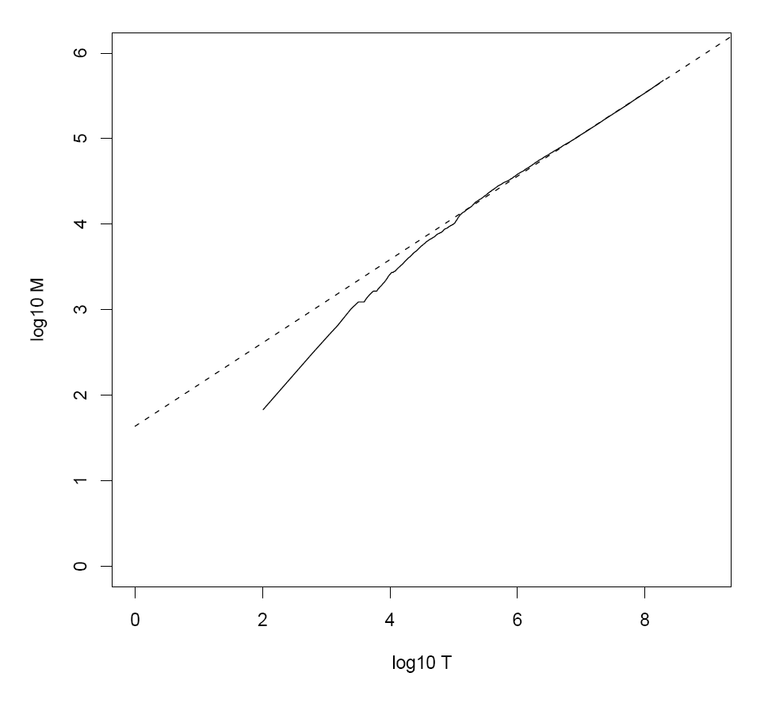
Heaps’ Law for RCV1
k = 44
b = 0.49
First 1,000,020 terms:
Predicted = 38,323
Actual = 38,365
Reuters-RCV1 collection: 806,791 newswire documents (Aug 20, 1996-August 19, 1997)
Manning, Raghavan, Schütze, Introduction to Information Retrieval (2008)

Slide 58
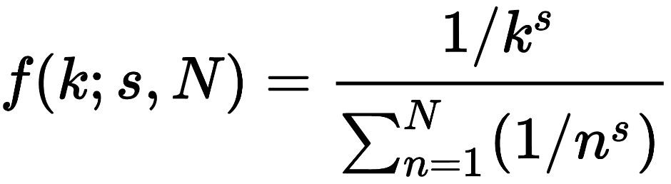
Postings Size: Zipf’s Law
N number of elements
k rank
s characteristic exponent
Zipf’s Law: (also) linear in log-log space
Specific case of Power Law distributions
In other words:
A few elements occur very frequently
Many elements occur very infrequently
Notes:
22

Slide 59
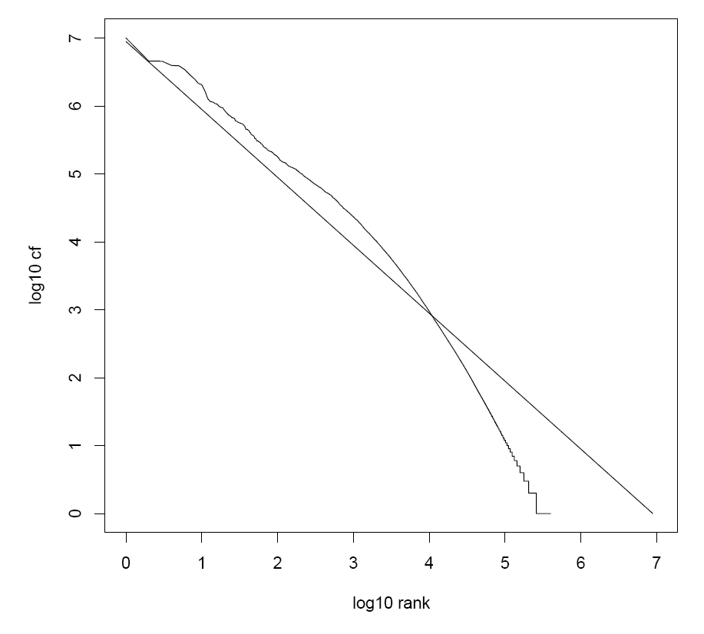
Zipf’s Law for RCV1
Fit isn’t that good… but good enough!
Reuters-RCV1 collection: 806,791 newswire documents (Aug 20, 1996-August 19, 1997)
Manning, Raghavan, Schütze, Introduction to Information Retrieval (2008)

Slide 60
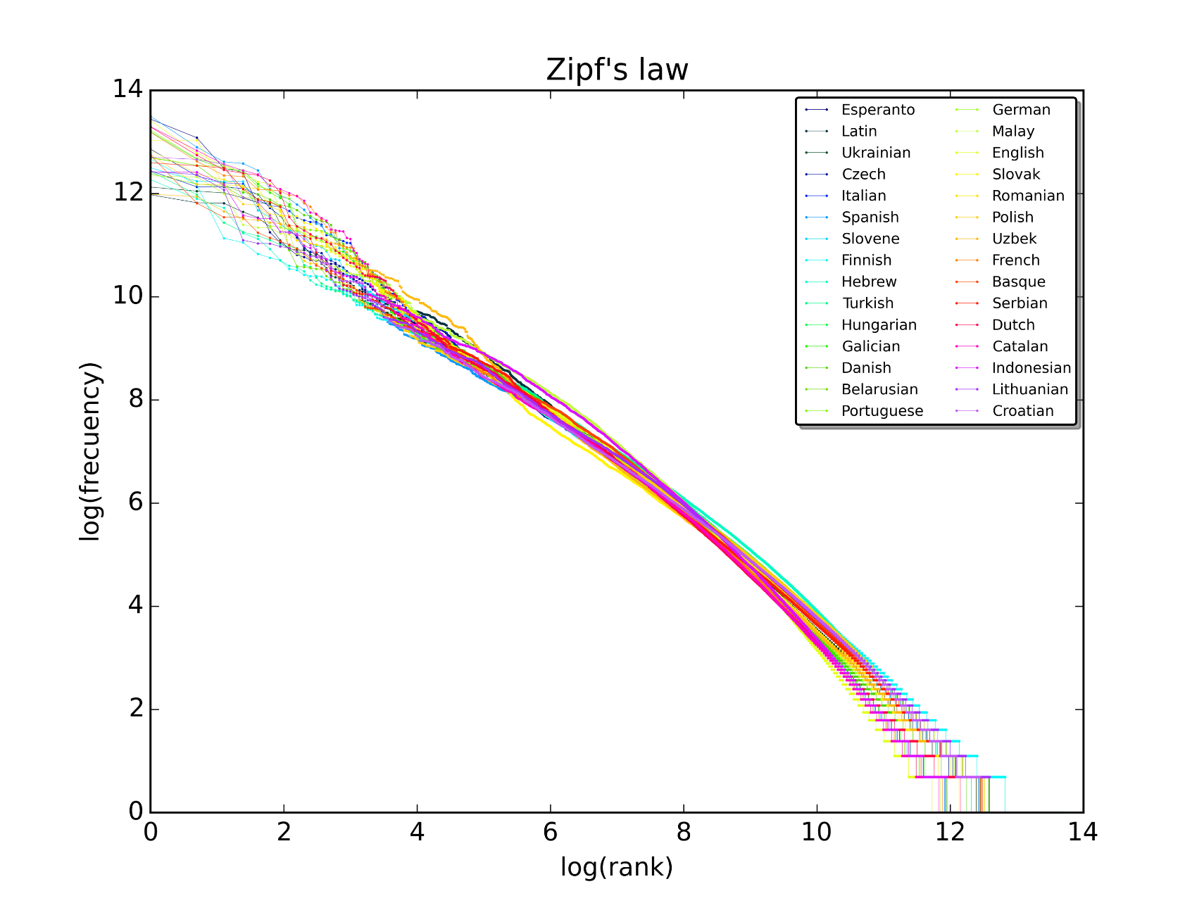
Zipf’s Law for Wikipedia
Rank versus frequency for the first 10m words in 30 Wikipedias (dumps from October 2015)

Slide 61
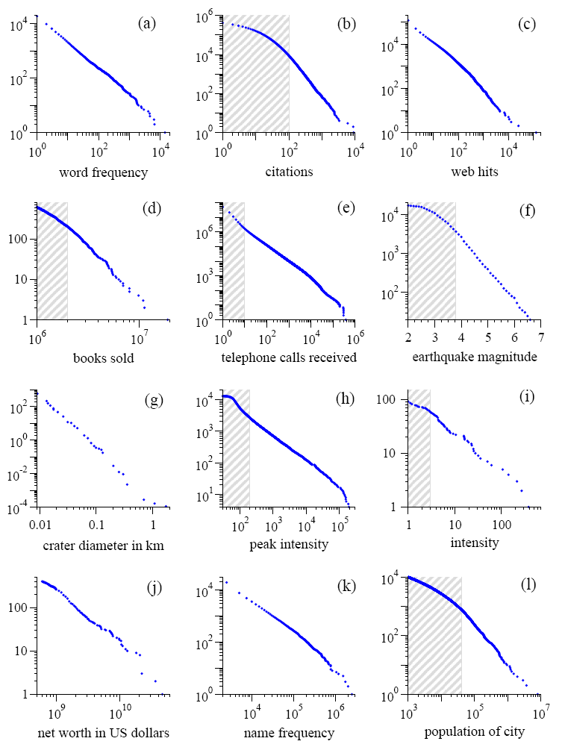
Power Laws are everywhere!
Figure from: Newman, M. E. J. (2005) “Power laws, Pareto distributions and Zipf's law.” Contemporary Physics 46:323–351.

Slide 62
MapReduce: Index Construction
Map over all documents
Emit term as key, (docid, tf) as value
Emit other information as necessary (e.g., term position)
Sort/shuffle: group postings by term
Reduce
Gather and sort the postings (typically by docid)
Write postings to disk
MapReduce does all the heavy lifting!

Slide 63
Inverted Indexing with MapReduce
Doc 1
Doc 2
Doc 3
one fish, two fish
red fish, blue fish
cat in the hat
one
1
1
red
2
1
cat
3
1
Map
two
blue
hat
1
1
2
1
3
1
fish
1
2
fish
2
2
Shuffle and Sort: aggregate values by keys
cat
3
1
Reduce
blue
2
1
fish
1
2
2
2
hat
3
1
one
1
1
two
1
1
red
2
1

Slide 64
Inverted Indexing: Pseudo-Code
class Mapper {
def map(docid: Long, doc: String) = {
val counts = new Map()
for (term <- tokenize(doc)) {
counts(term) += 1
}
for ((term, tf) <- counts) {
emit(term, (docid, tf))
}
}
}
class Reducer {
def reduce(term: String, postings: Iterable[(docid, tf)]) = {
val p = new List()
for ((docid, tf) <- postings) {
p.append((docid, tf))
}
p.sort()
emit(term, p)
}
}
What’s the problem?
Stay tuned…

Slide 65

Source: Wikipedia (Japanese rock garden)

